Slide 1
Obtain Credentials for Twitter API
Website: https://developer.twitter.com/en/apps
Apply for Twitter Developer Account under APP section
Primary reason for accessing Twitter API
Country
Plan to use Twitter Data
Specific detail about data analysis
Plan for using Tweet, Retweet, like, follow, or Direct Message
Plan for displaying data outside of Twitter
Government entities
Twitter may also follow up for additional details using email

Slide 2
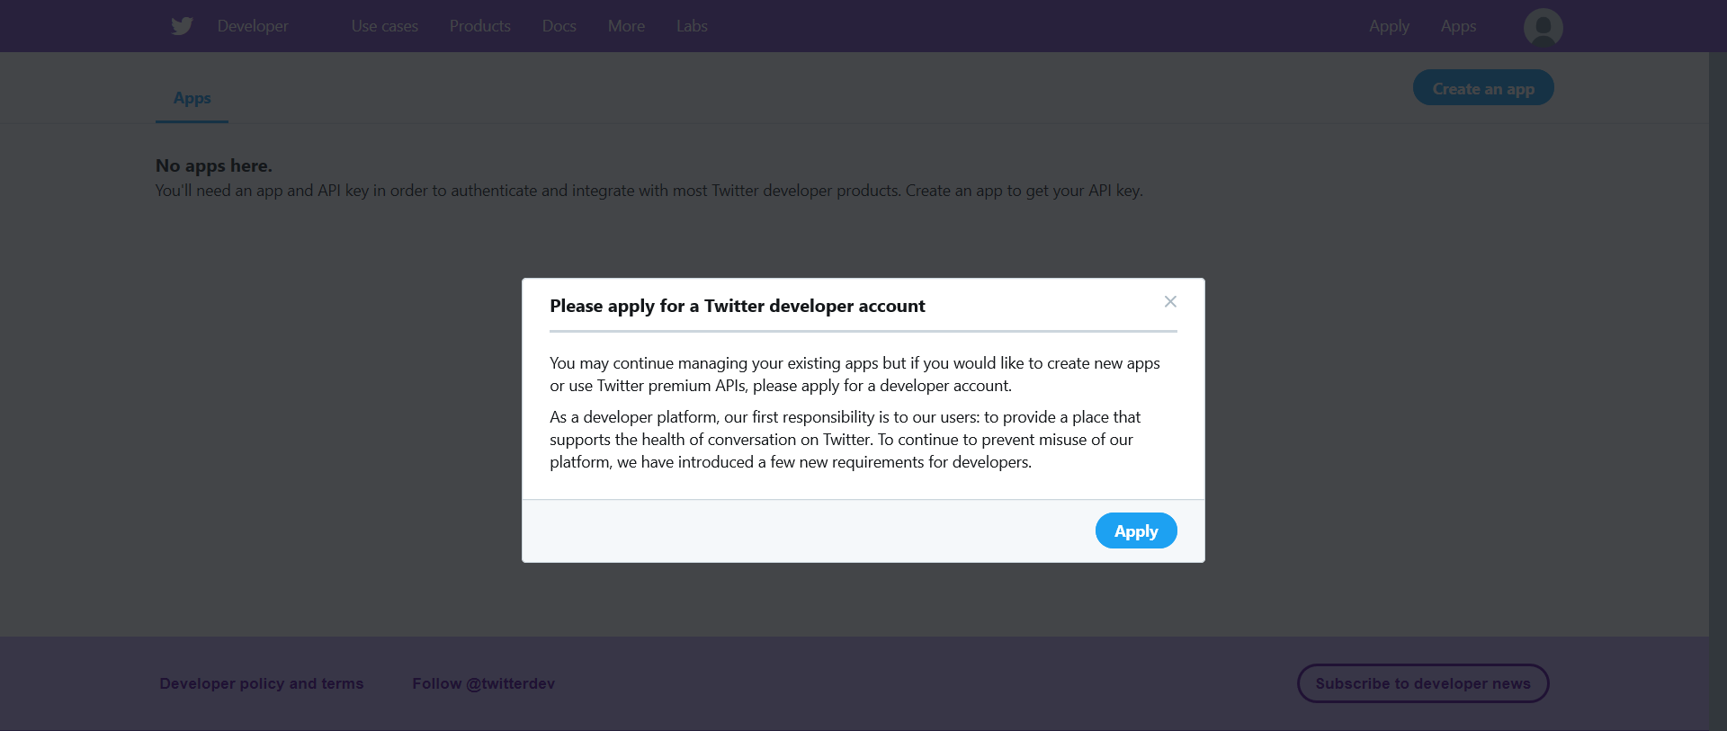

Slide 3
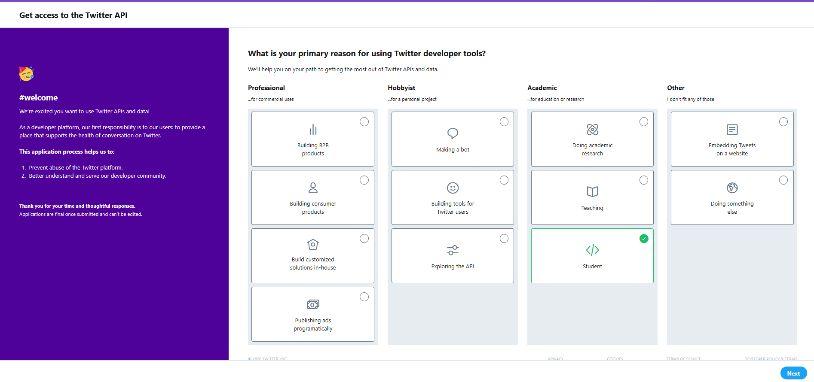

Slide 4
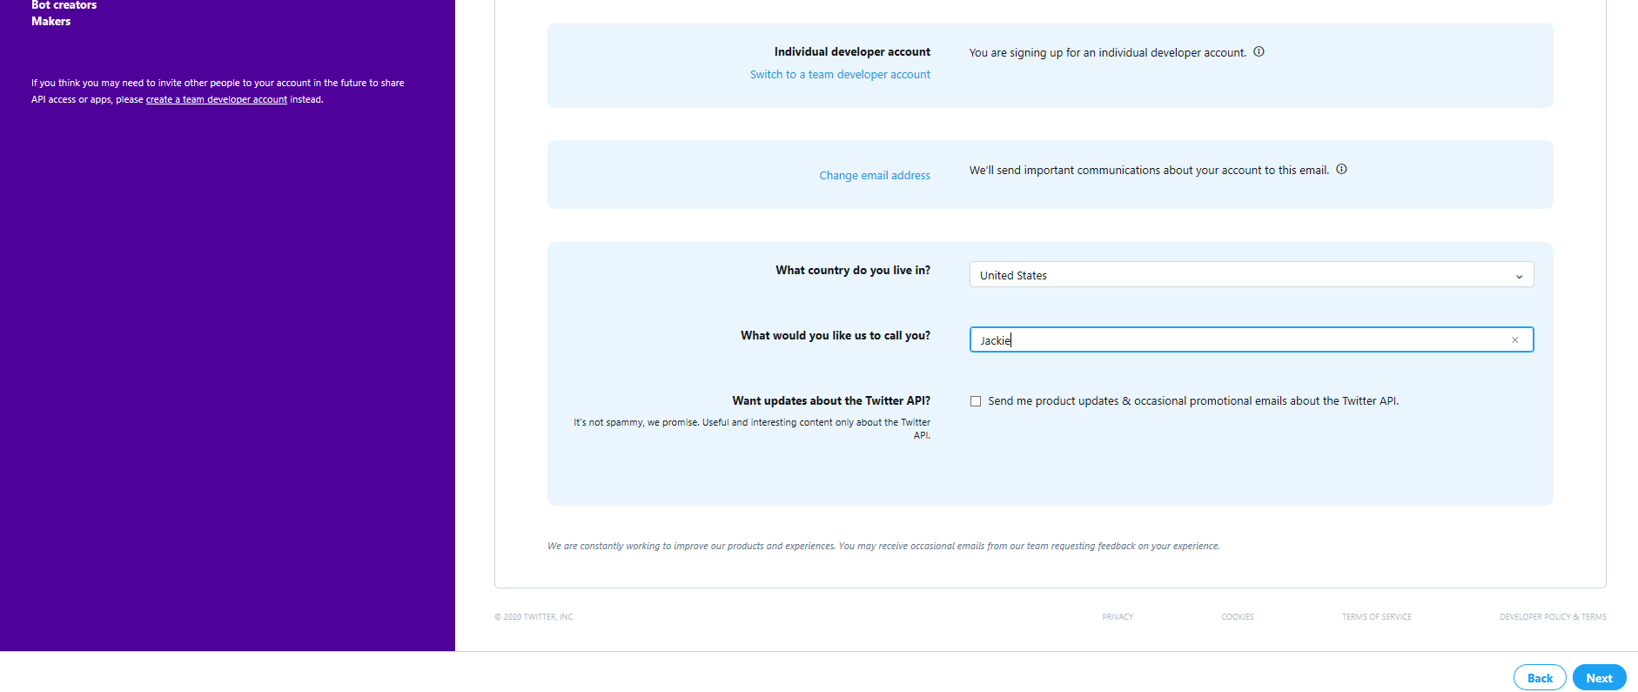

Slide 5
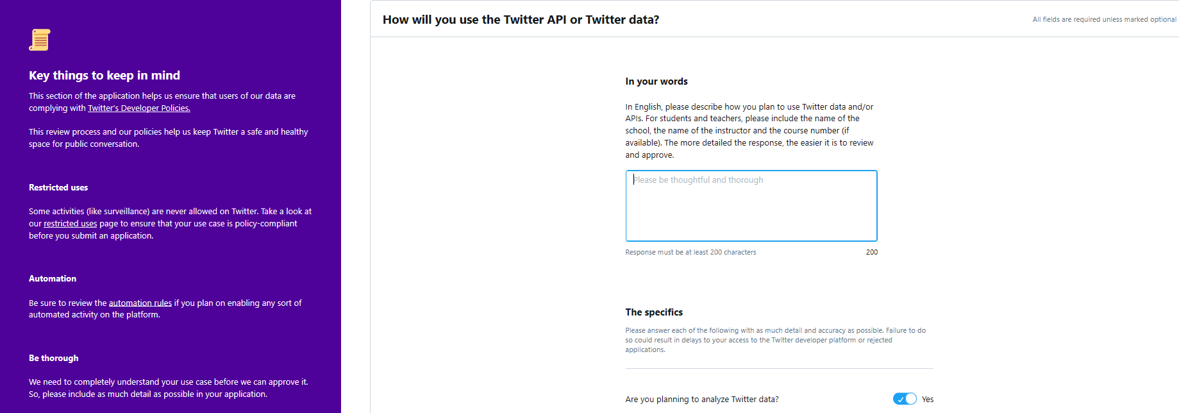

Slide 6
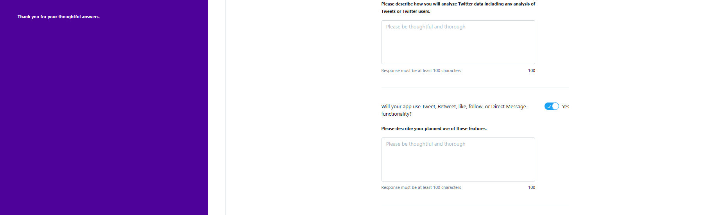

Slide 7


